Slide 1
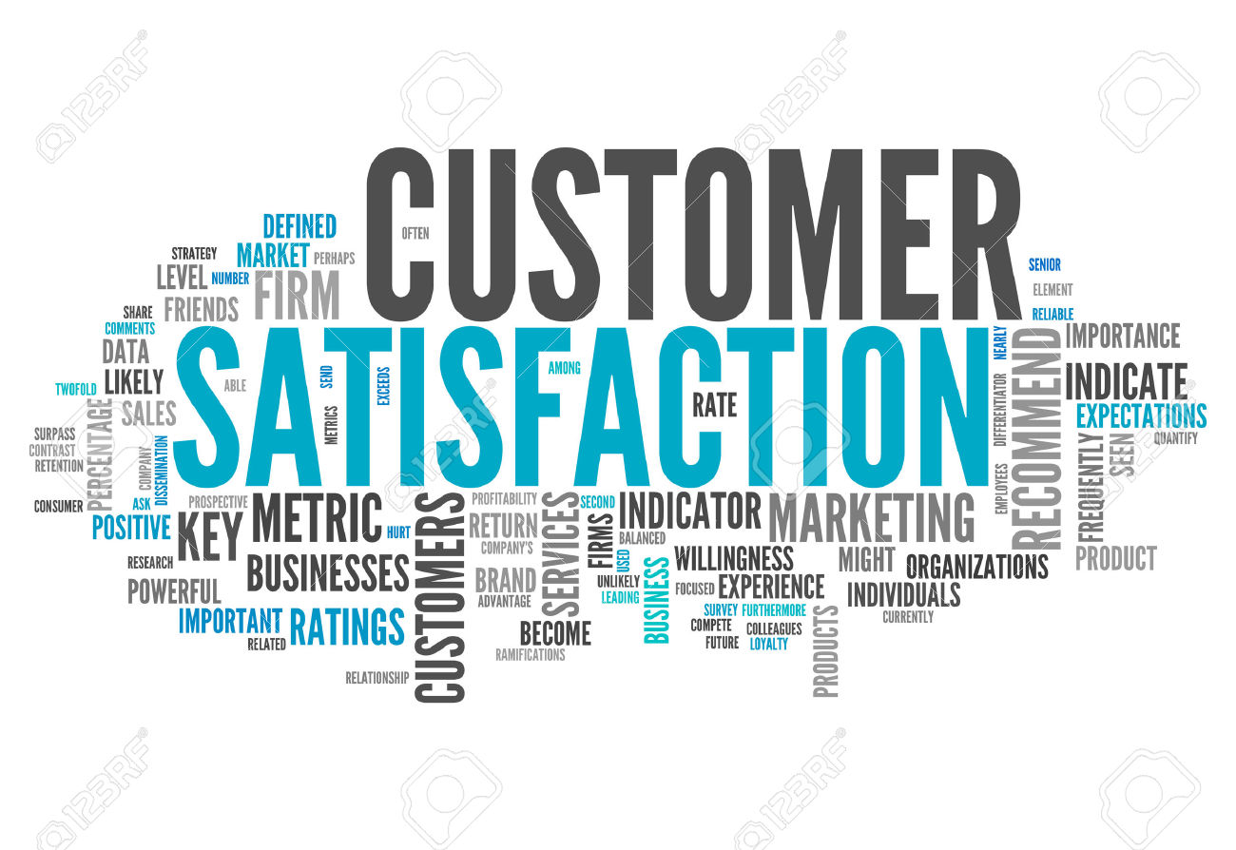
Satisfaction Modeling
Akshay Kher
April 1, 2016

Slide 2
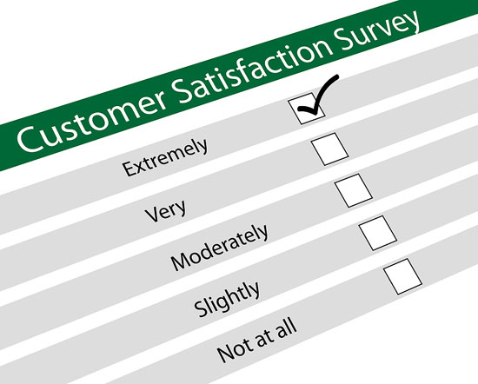
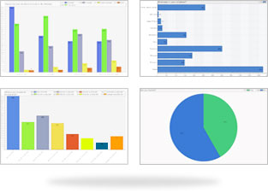
Background / Objective
Background
Marketers are keen to understand the relationship between customer satisfaction and sales. They want to know what drives satisfaction and its contribution in driving net sales.
Objective
The primary objective of this study is to find ‘To what extent does satisfaction drive sales?’
Data
Customer level data for ~ 1MN customers. Also a dataset which includes responses based on a customer satisfaction survey.

Slide 3
Overall level of satisfaction in relatively high
 | Average Rating*
Overall Satisfaction | 6.5
Likely Recommend | 8.7
Likely Return | 6.5
Hospital Atmosphere | 6.5
Staff Friendly | 6.6
Vet Knowledge | 6.6
Vet Communicate | 6.7
Pet Care | 6.7
Checkout Process | 6.4
Payment Options | 5.9
Fair Prices | 5.5
*All survey responses range from 1-7 in increasing order of satisfaction. Likely Recommend ranges from 0-10

Slide 4
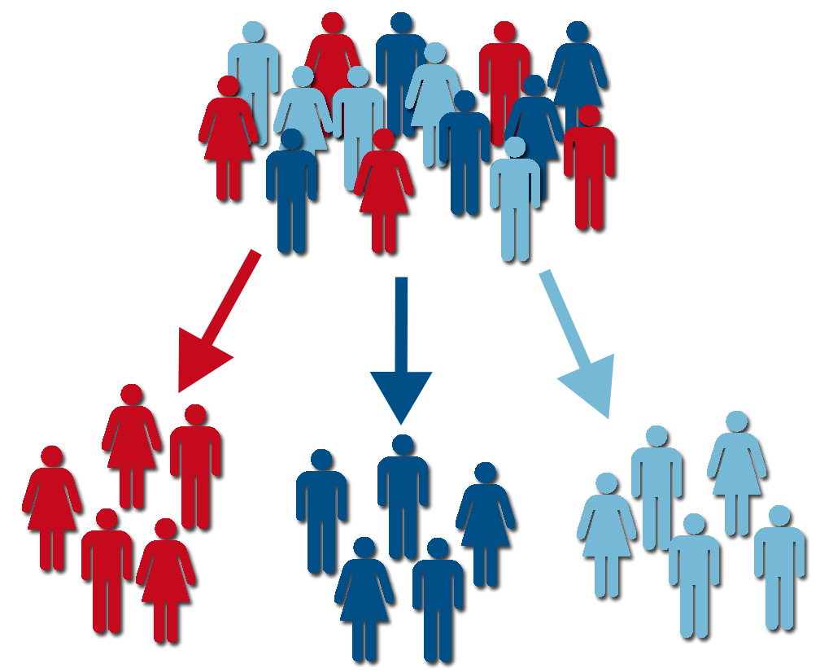
Which customer segments drive satisfaction for the client?

Slide 5
Segmentation
Based on consumer behavior variables; transaction variables, service usage variables
Variables tested for non-normality by checking z scores > +/- 3.0 standard deviations
Segmentation done using Latent Gold
Following variables were significant for segmentation:
Average Days Between Visits
Average Price Paid
Overall Satisfaction
Hospital Atmosphere
Likely Return
Total Units
Various cluster solutions tried. Optimum number of clusters found: 3

Slide 6

Segment 1: The Satisfied Lot
54% of the customer base
Average Satisfaction Score: 6.9
Average Price Paid: $ 23.9
Average Units Bought: 158
Likely Recommend Score: 9.4
Average Days Between Visits: 64

Slide 7

Segment 2: The Middle men
28% of the customer base
Average Satisfaction Score: 6.4
Average Price Paid: $ 24.5
Average Units Bought: 134
Likely Recommend Score: 8.5
Average Days Between Visits: 69

Slide 8

Segment 3: The Discontented Lot
18% of the customer base
Average Satisfaction Score: 5.3
Average Price Paid: $ 24.4
Average Units Bought: 130
Fair Prices Score: 4.0
Average Days Between Visits: 70

Slide 9
Simultaneous Equations Modeling
Dependent Variable: Total Units
Procedure Used: Proc Syslin 2SLS
Endogenous Variable: Overall_Sat
Instruments: LIKELY_RECOMMEND LIKELY_RETURN HOSPITAL_ATMOSPHERE STAFF_FRIENDLY STAFF_PREPARED KEPT_INFORMED VET_KNOWLEDGE VET_COMMUNICATE PET_CARE CARING_AT_HOME COST_NEXT_VISIT PET_NEXT_VISIT CHECKOUT_PROCESS PAYMENT_OPTIONS FAIR_PRICES price avg_days_between num_invoices
Models run by: Segment

Slide 10
Segment 1: What drives satisfaction? To what extent does satisfaction drive sales?
Dependent Variable: Overall Satisfaction
Dependent Variable: Unit Sales
Variable | % Impact
Likely Recommend | 2.6%
Kept Informed | 1.4%
Pet Next Visit | 1.0%
Checkout Process | 6.2%
Fair Prices | 1.4%
Variable | % Impact
Overall Satisfaction | -2.9%
Price | -2.4%
Average days between visits | 5.0%
No of invoices | 2.8%
Highly satisfied customers
More likely to recommend to friends and family
Most satisfied with prices and check out process
Already satisfied, so satisfaction does not drive sales for this segment
Price inelastic

Slide 11
Segment 2: What drives satisfaction? To what extent does satisfaction drive sales?
Dependent Variable: Overall Satisfaction
Dependent Variable: Unit Sales
Variable | % Impact
Likely Recommend | 18.1%
Kept Informed | 2.4%
Pet Next Visit | 2.3%
Fair Prices | 6.9%
Caring at Home | -3.8%
Vet Knowledge | 13.8%
Staff Prepared | 5.4%
Hospital Atmosphere | -5.3%
Likely Return | 4.5%
Payment Options | -3.4%
Variable | % Impact
Overall Satisfaction | 23.9%
Price | -7.0%
Average days between visits | 3.0%
No of invoices | 8.0%
Most likely to recommend to friends and family
Satisfaction driven by perceived high vet knowledge and staff preparedness
Satisfaction high driver of unit sales

Slide 12
Segment 3: What drives satisfaction? To what extent does satisfaction drive sales?
Dependent Variable: Overall Satisfaction
Dependent Variable: Unit Sales
Variable | % Impact
Likely Recommend | 32.1%
Kept Informed | 3.5%
Fair Prices | 3.7%
Vet Knowledge | 3.2%
Staff Prepared | 5.9%
Hospital Atmosphere | -10.8%
Likely Return | 33.1%
Payment Options | -3.2%
Vet Communicate | -3.2%
Pet Care | 5.0%
Staff Friendly | -4.9%
Cost Next Visit | 4.0%
Variable | % Impact
Overall Satisfaction | -12.5%
Price | -6.2%
Average days between visits | 2.6%
No of invoices | 5.5%
Most likely to return for another visit
Satisfaction not a major driver of unit sales

Slide 13
Financial Implications
Financial Implications have been calculated on the basis of potential revenue gain as a result of improving overall satisfaction
Since price is inelastic throughout, an increase in price will increase net revenue
Revenue gain had been calculated assuming a 10% improvement in overall satisfaction and a 10% price increase for all the 3 segments

Slide 14
Revenue Gain by increasing satisfaction
 |  | Elasticity | Old Mean | New Mean | New Revenue | Old Revenue | Revenue Gain
Segment 1 | Overall Satisfaction | -8.4 | 6.95 | 7.65 | $ 656 | $ 3,796 | $ 691
 | Price | -0.82 | 23.92 | 26.31 | $ 3,832
Segment 2 | Overall Satisfaction | 0.03 | 6.45 | 7.09 | $ 3,639 | $ 3,297 | $ 3,692
 | Price | -0.76 | 24.57 | 27.03 | $ 3,351
Segment 3 | Overall Satisfaction | -0.12 | 5.36 | 5.90 | $ 3,450 | $ 3,176 | $ 3,502
 | Price | -0.76 | 24.43 | 26.87 | $ 3,227
An improvement in satisfaction for Segment 2 results in maximum revenue gain followed by Segment 3
Above modeling plan can be tested using segment sensitivities as strategy
10% sample size of each segment can be used to test the modeling strategies
Increased revenue can then be compared to that of the remaining segment to estimate model effectiveness and revenue gain

